Slide 1
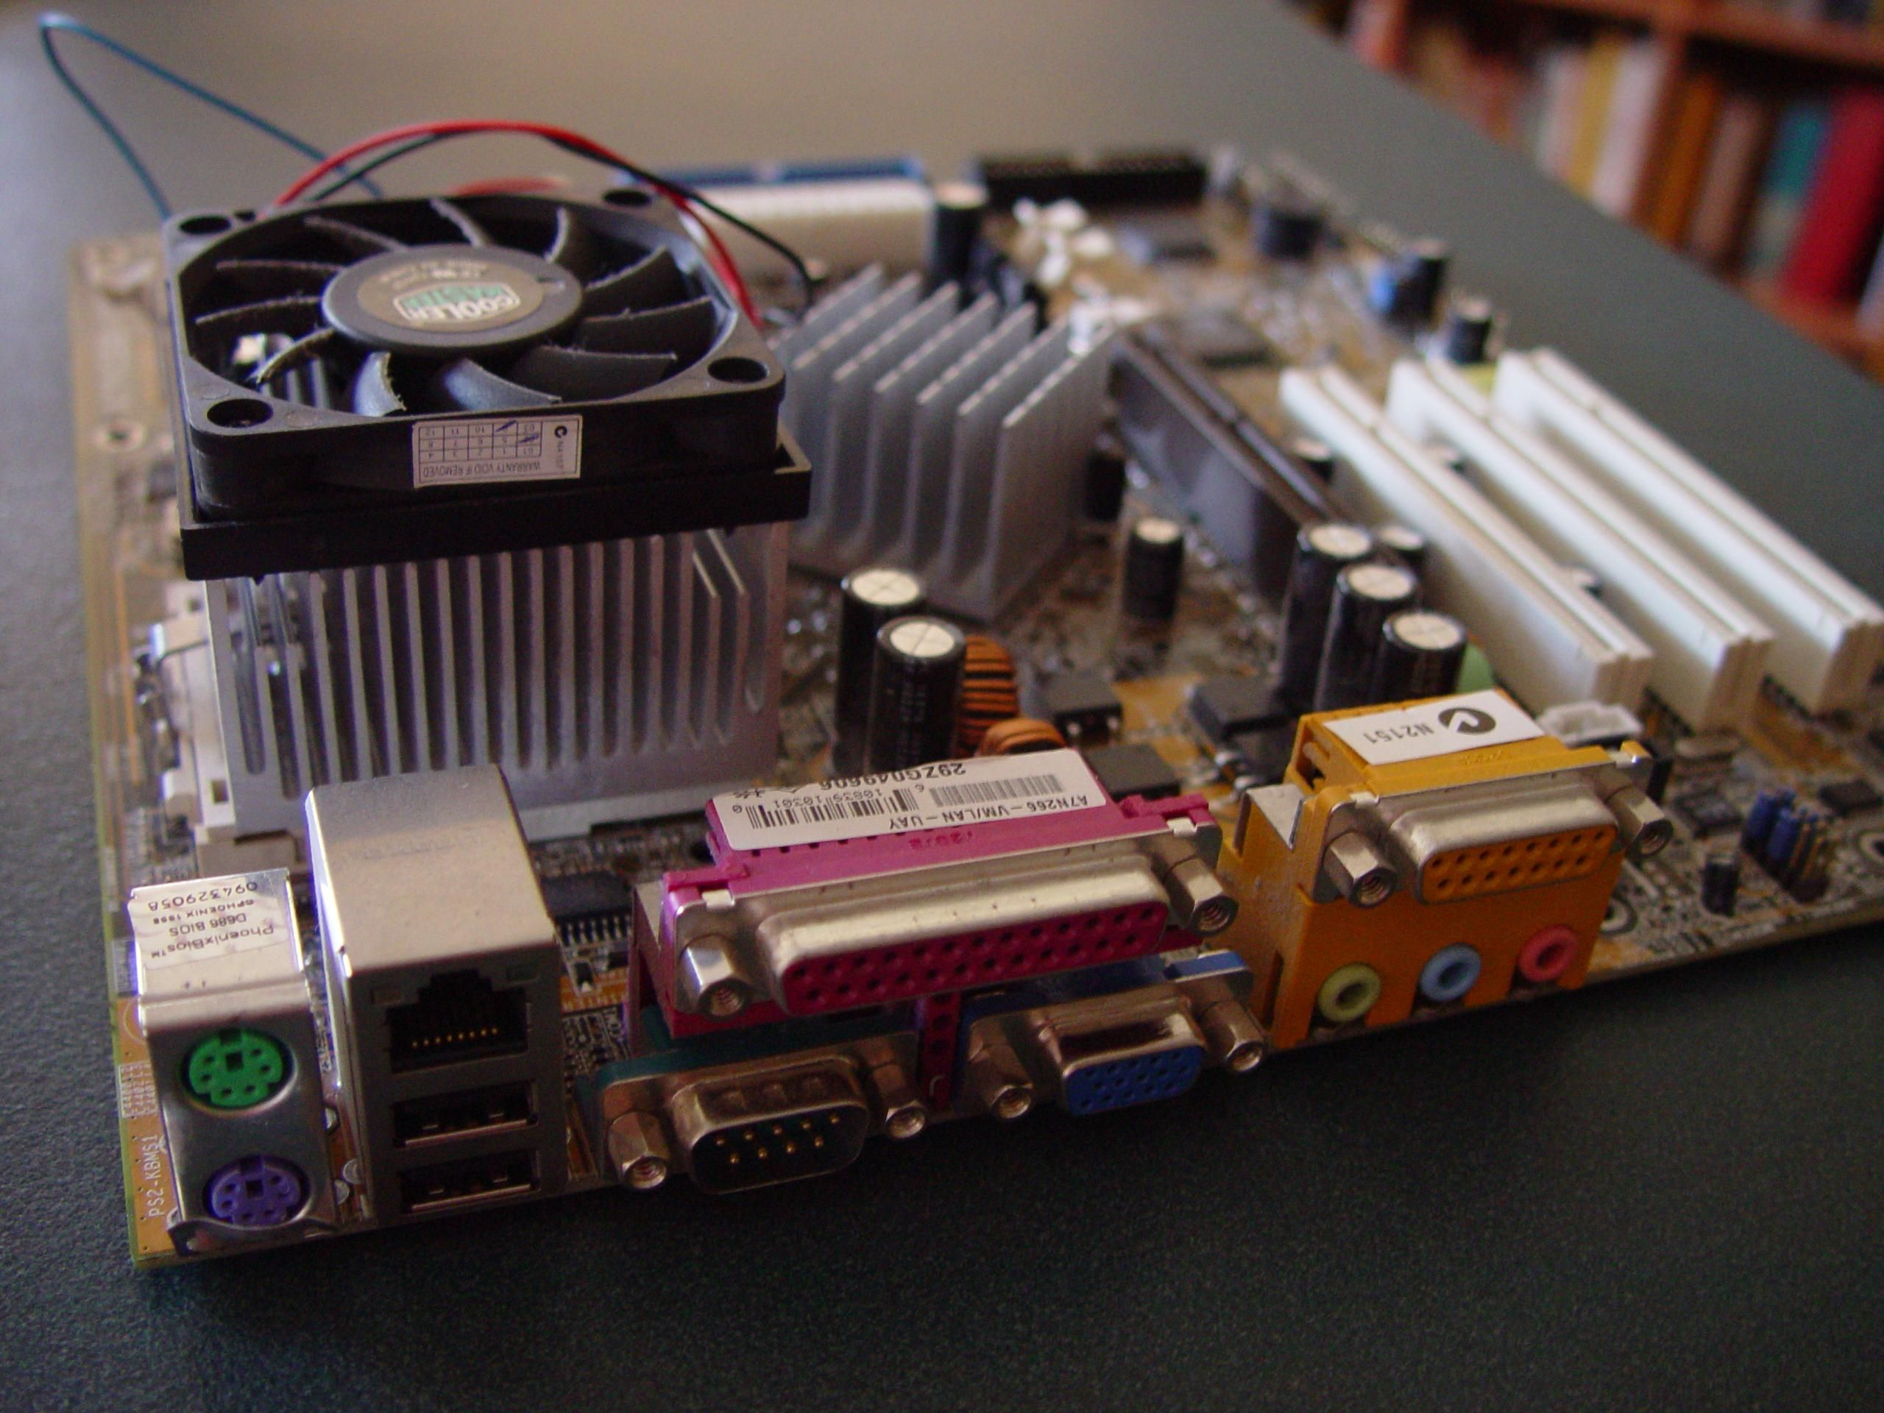
INTRODUCTION
Name: Mohammad Mohid
Topic: PCI and PCI Cards
Subject: ICT (Lab)
Class: Bs Data science
Group: B

Slide 2
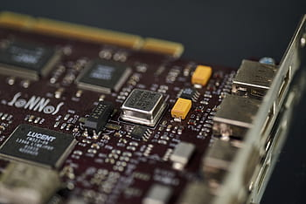
What is PCI:
Peripheral Component Interconnect.
Connects Peripheral devices.
Example:
Network cards, sound cards etc.

Slide 3
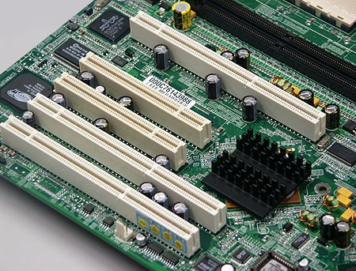
IMPORTANCE OF PCI:
High-speed data transfers between components.
Allows system expansion without modifying the motherboard.

Slide 4
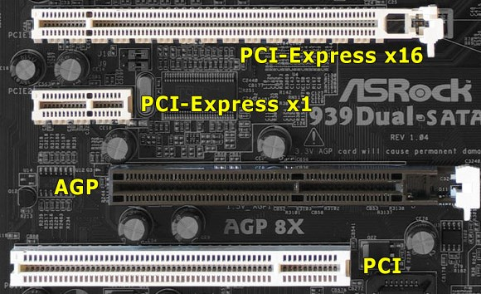
PCI SLOTS:

Slide 5
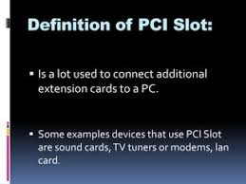

Slide 6
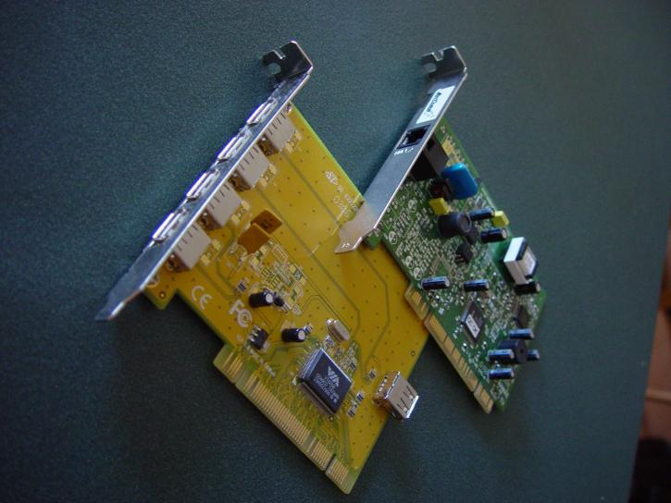
PCI CARDS:
Hardware components.
Plugs in to PCI slots on the motherboard.
Adds functionalities such
as additional ports.

Slide 7
TYPES OF PCI CARDS:
Network Interface Cards (NICs): For Ethernet or wireless network connectivity.
Sound Cards: For advanced audio processing.
Graphics Cards (GPU): For high-performance video output.
Storage Controllers: To support additional hard drives or SSDs.

Slide 8


